Slide 1


Slide 2
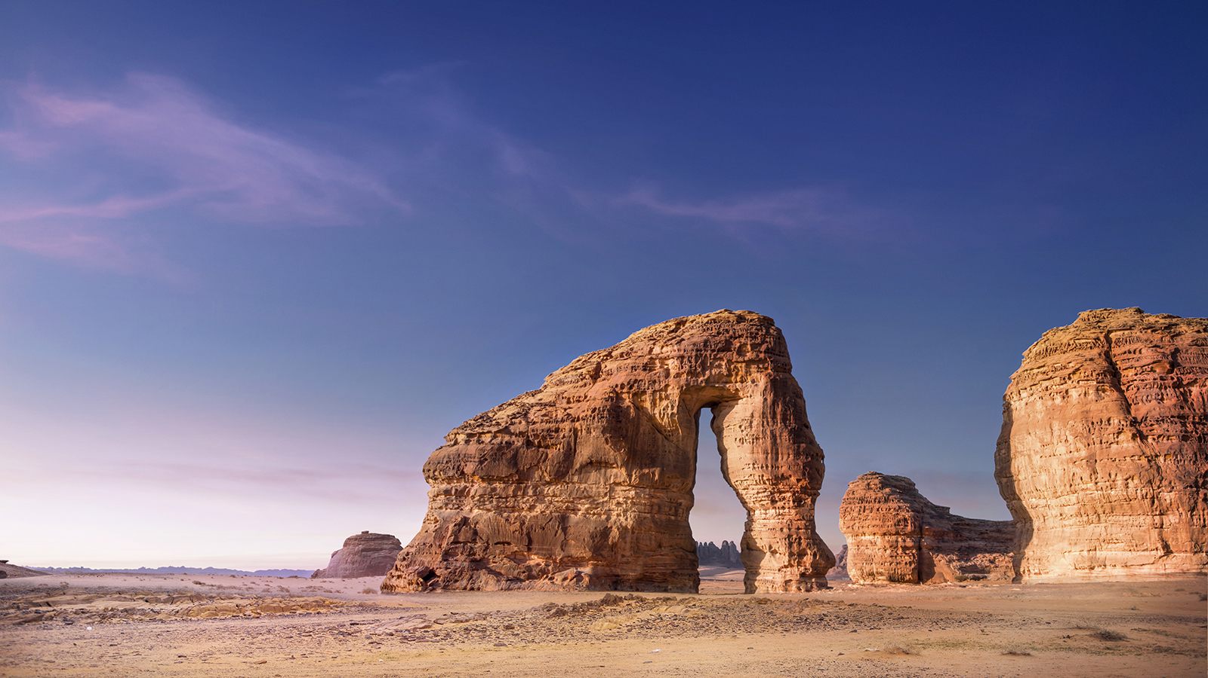
Hadeel Alharbi
Team Leader
TEAM MEMBERS
Abdulmohsen Alfreh
Haifa Alshareef
Arwa Fawzi
Mohammed Alkhaldi

Slide 3
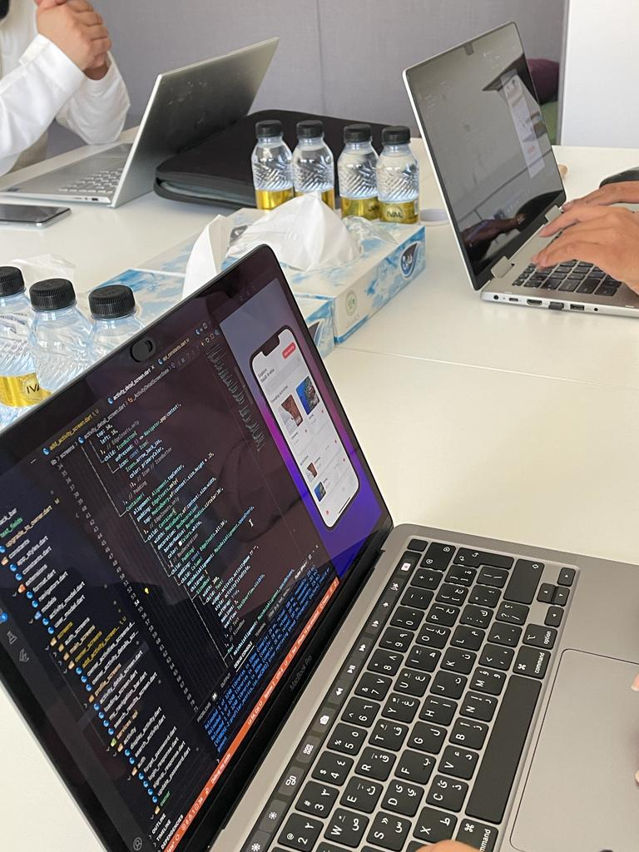
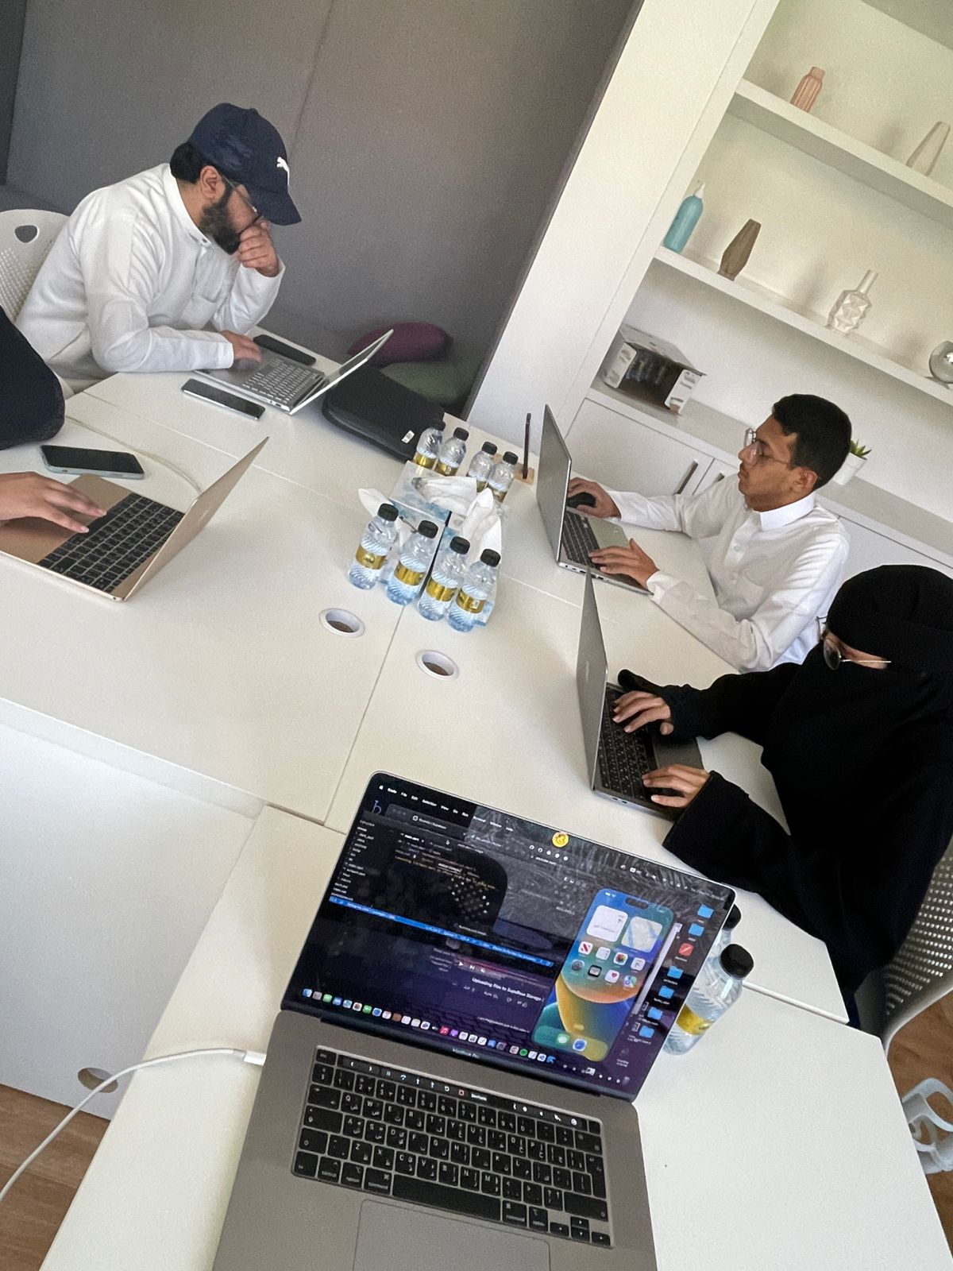
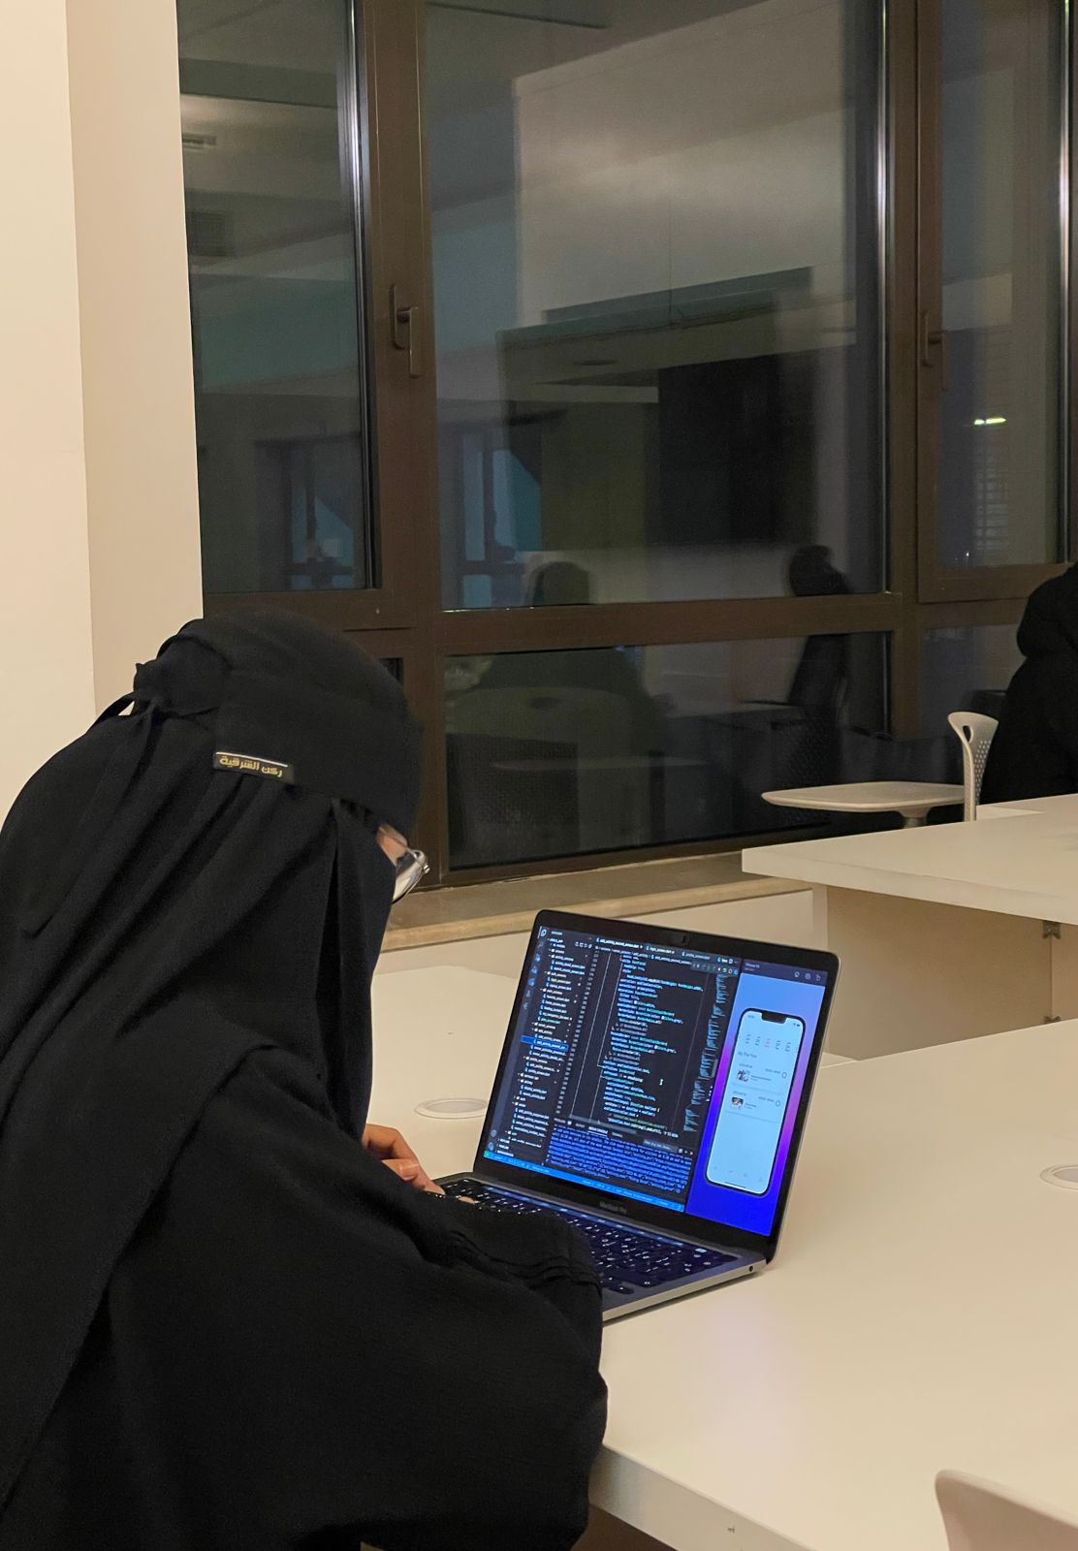


Slide 4
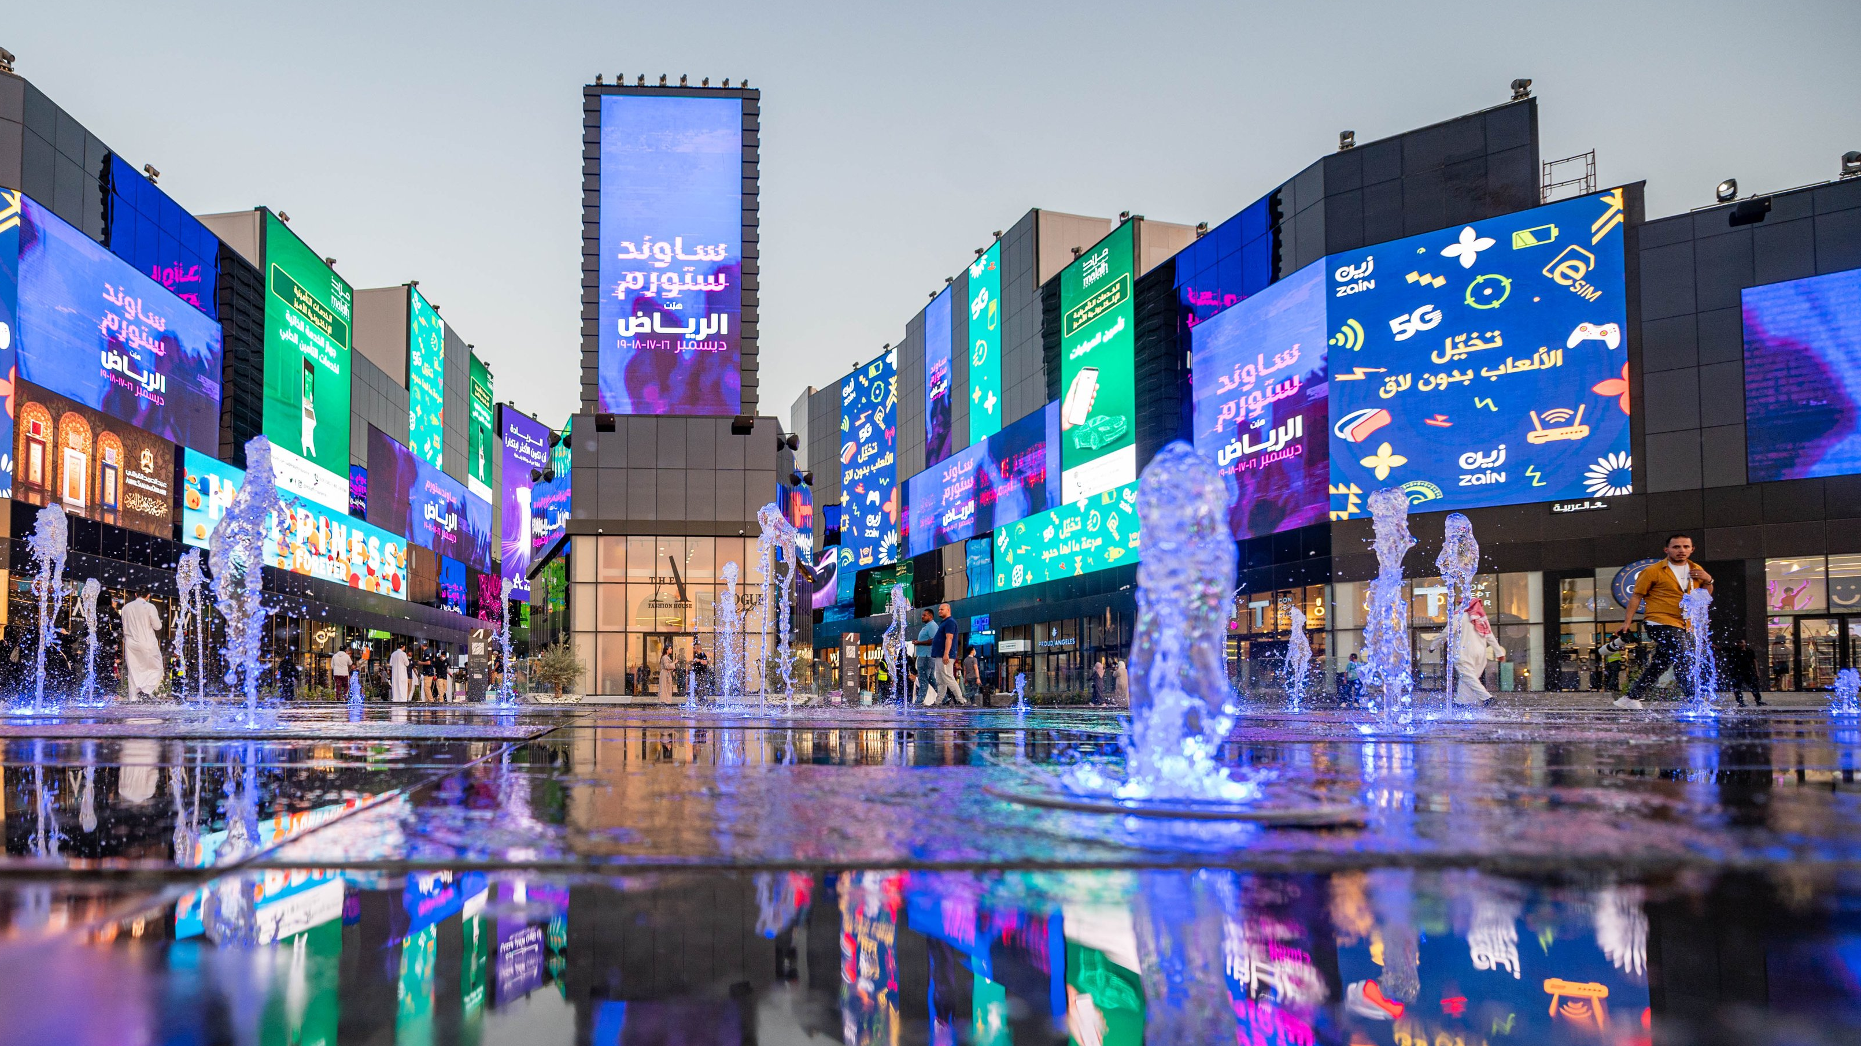
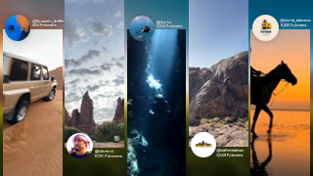
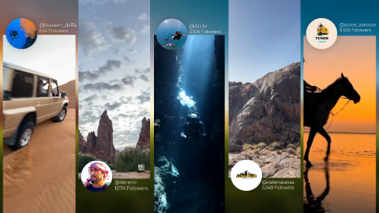
INTRODUCTION
JAWLA is an application that enables the clients to create an appropriate tourism plan for their tour within Saudi Arabia. It also makes an opportunity for Tourism Entrepreneurs to invest with us by adding their activities in our application.

Slide 5

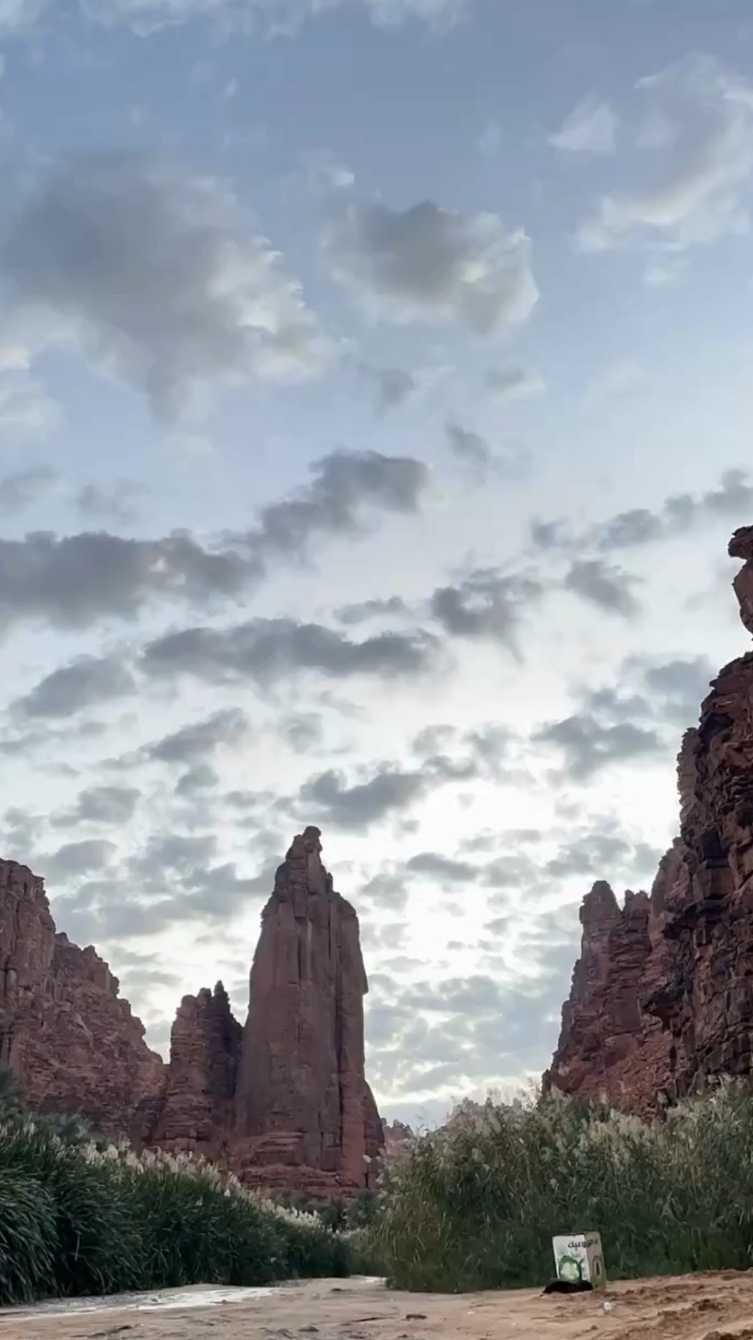
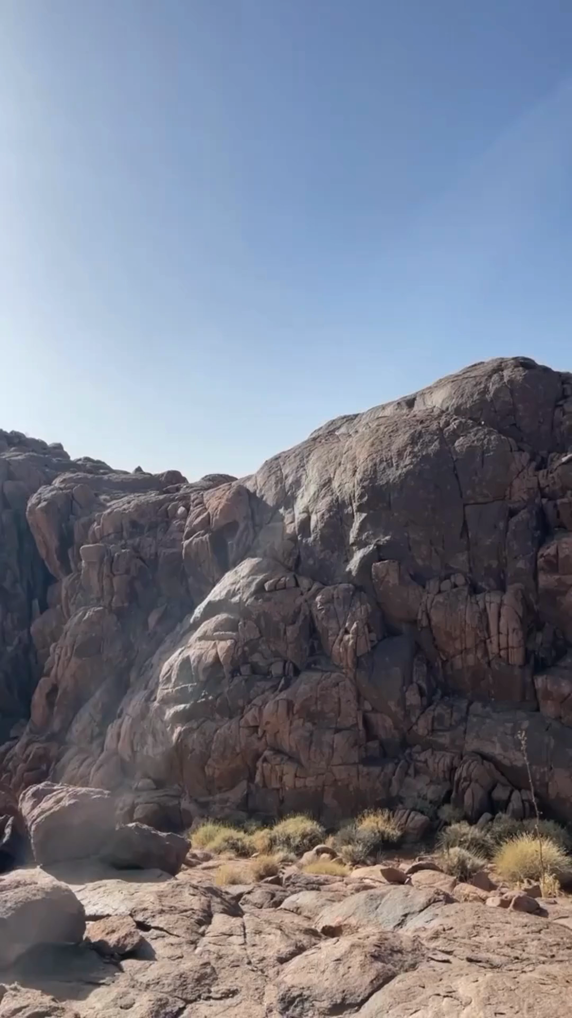
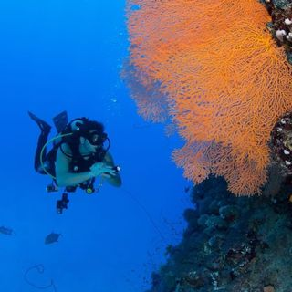


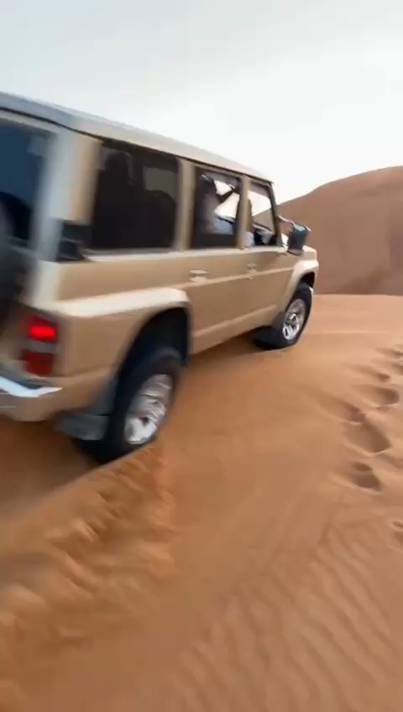




@hussein_daffa
634 Folowers
@3zz.br
3,104 Folowers
@durrat_alarooos
9,555 Folowers
@dereinii
107K Folowers
@viaferrataksa
5,549 Folowers

Slide 6





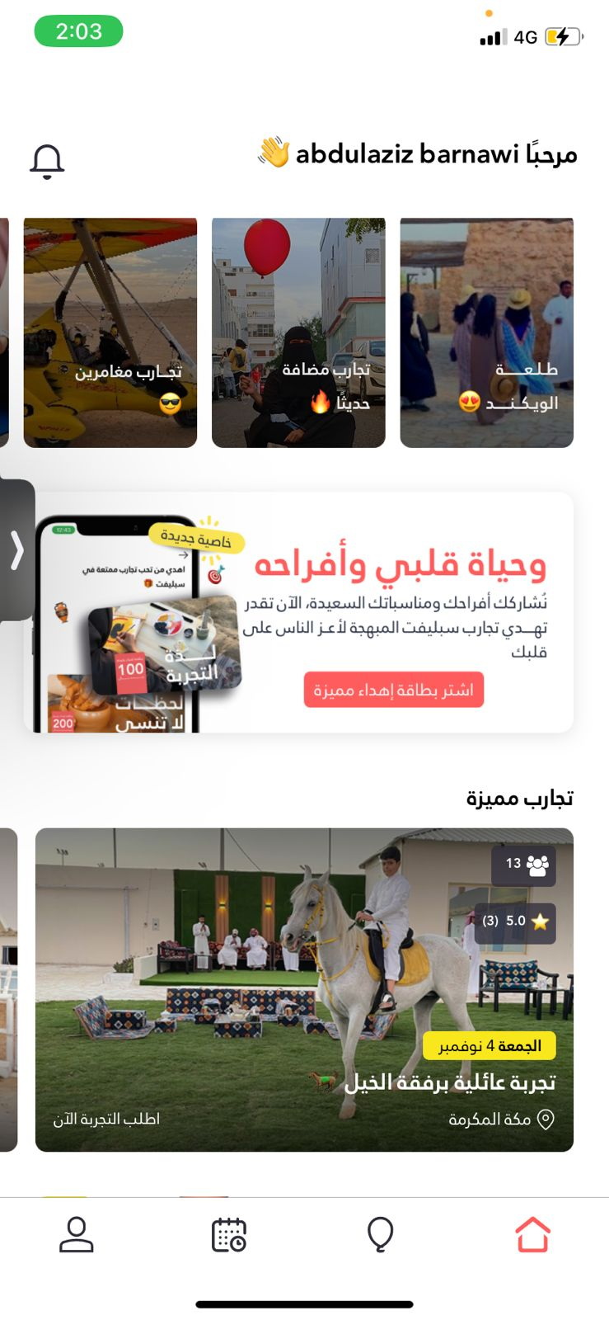
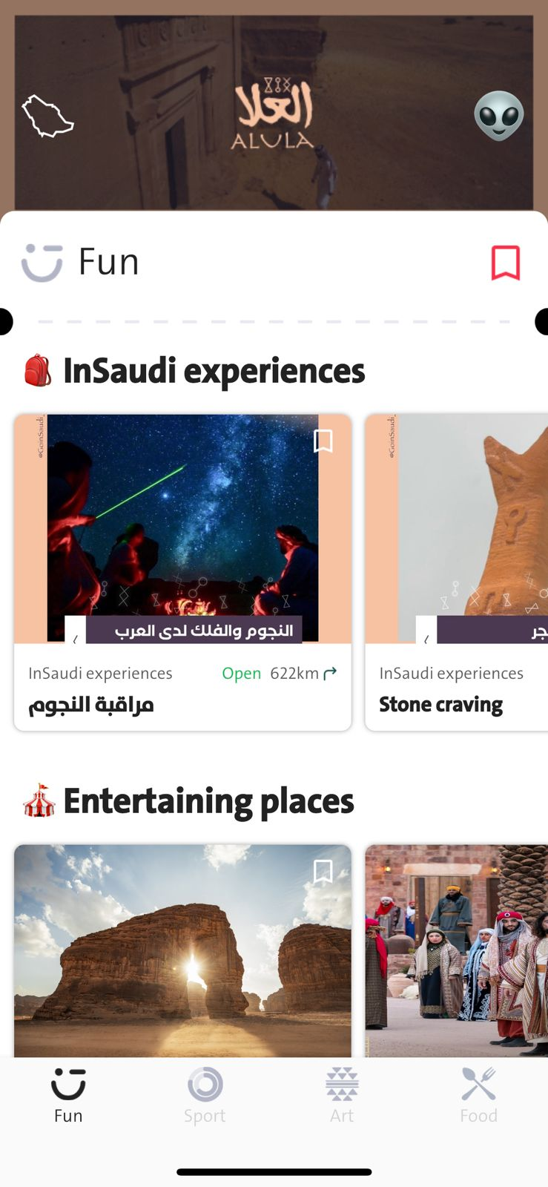
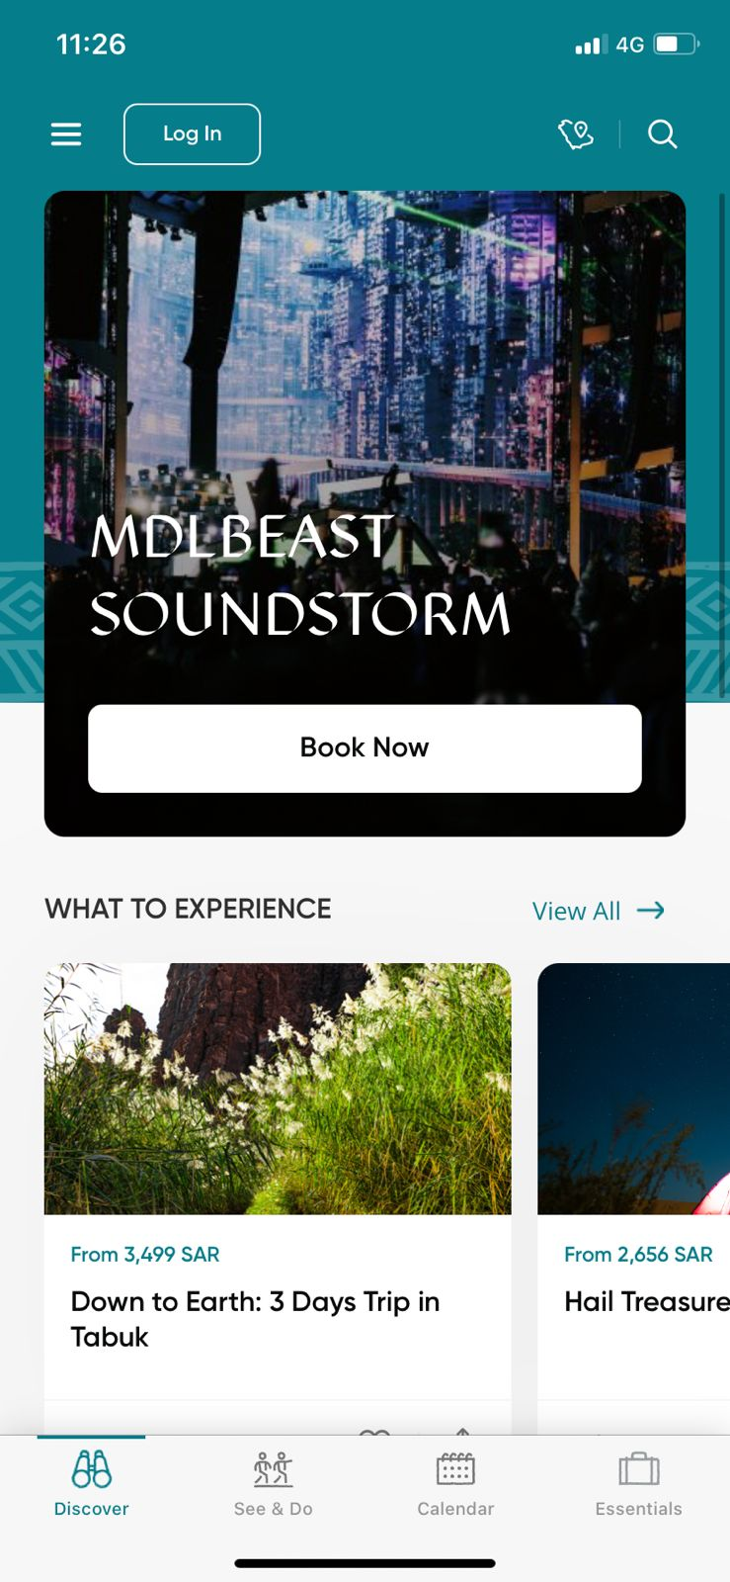
EXISTING SYSTEMS
Visit Saudi app has many features but its trips are very detailed and inflexible and very expensive. In the other hand, InSaudi app doesn't have the reservation system feature. However, in Suplift app you can't plan for your trip.

Slide 7
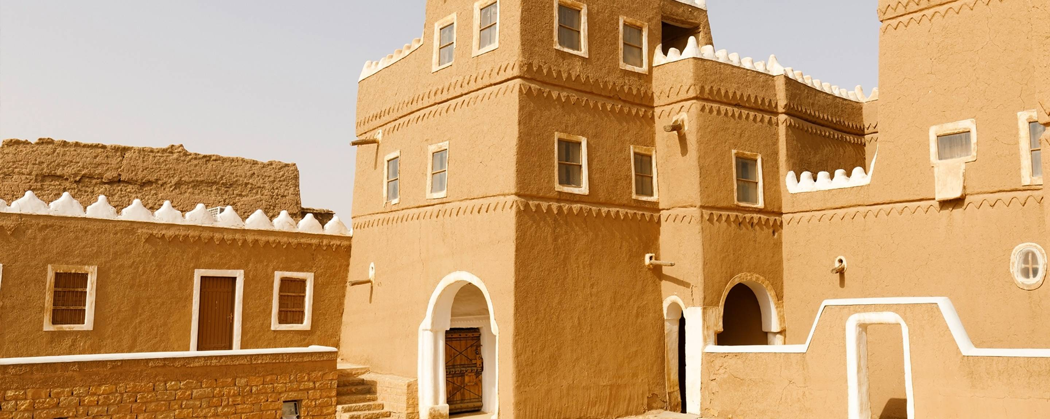
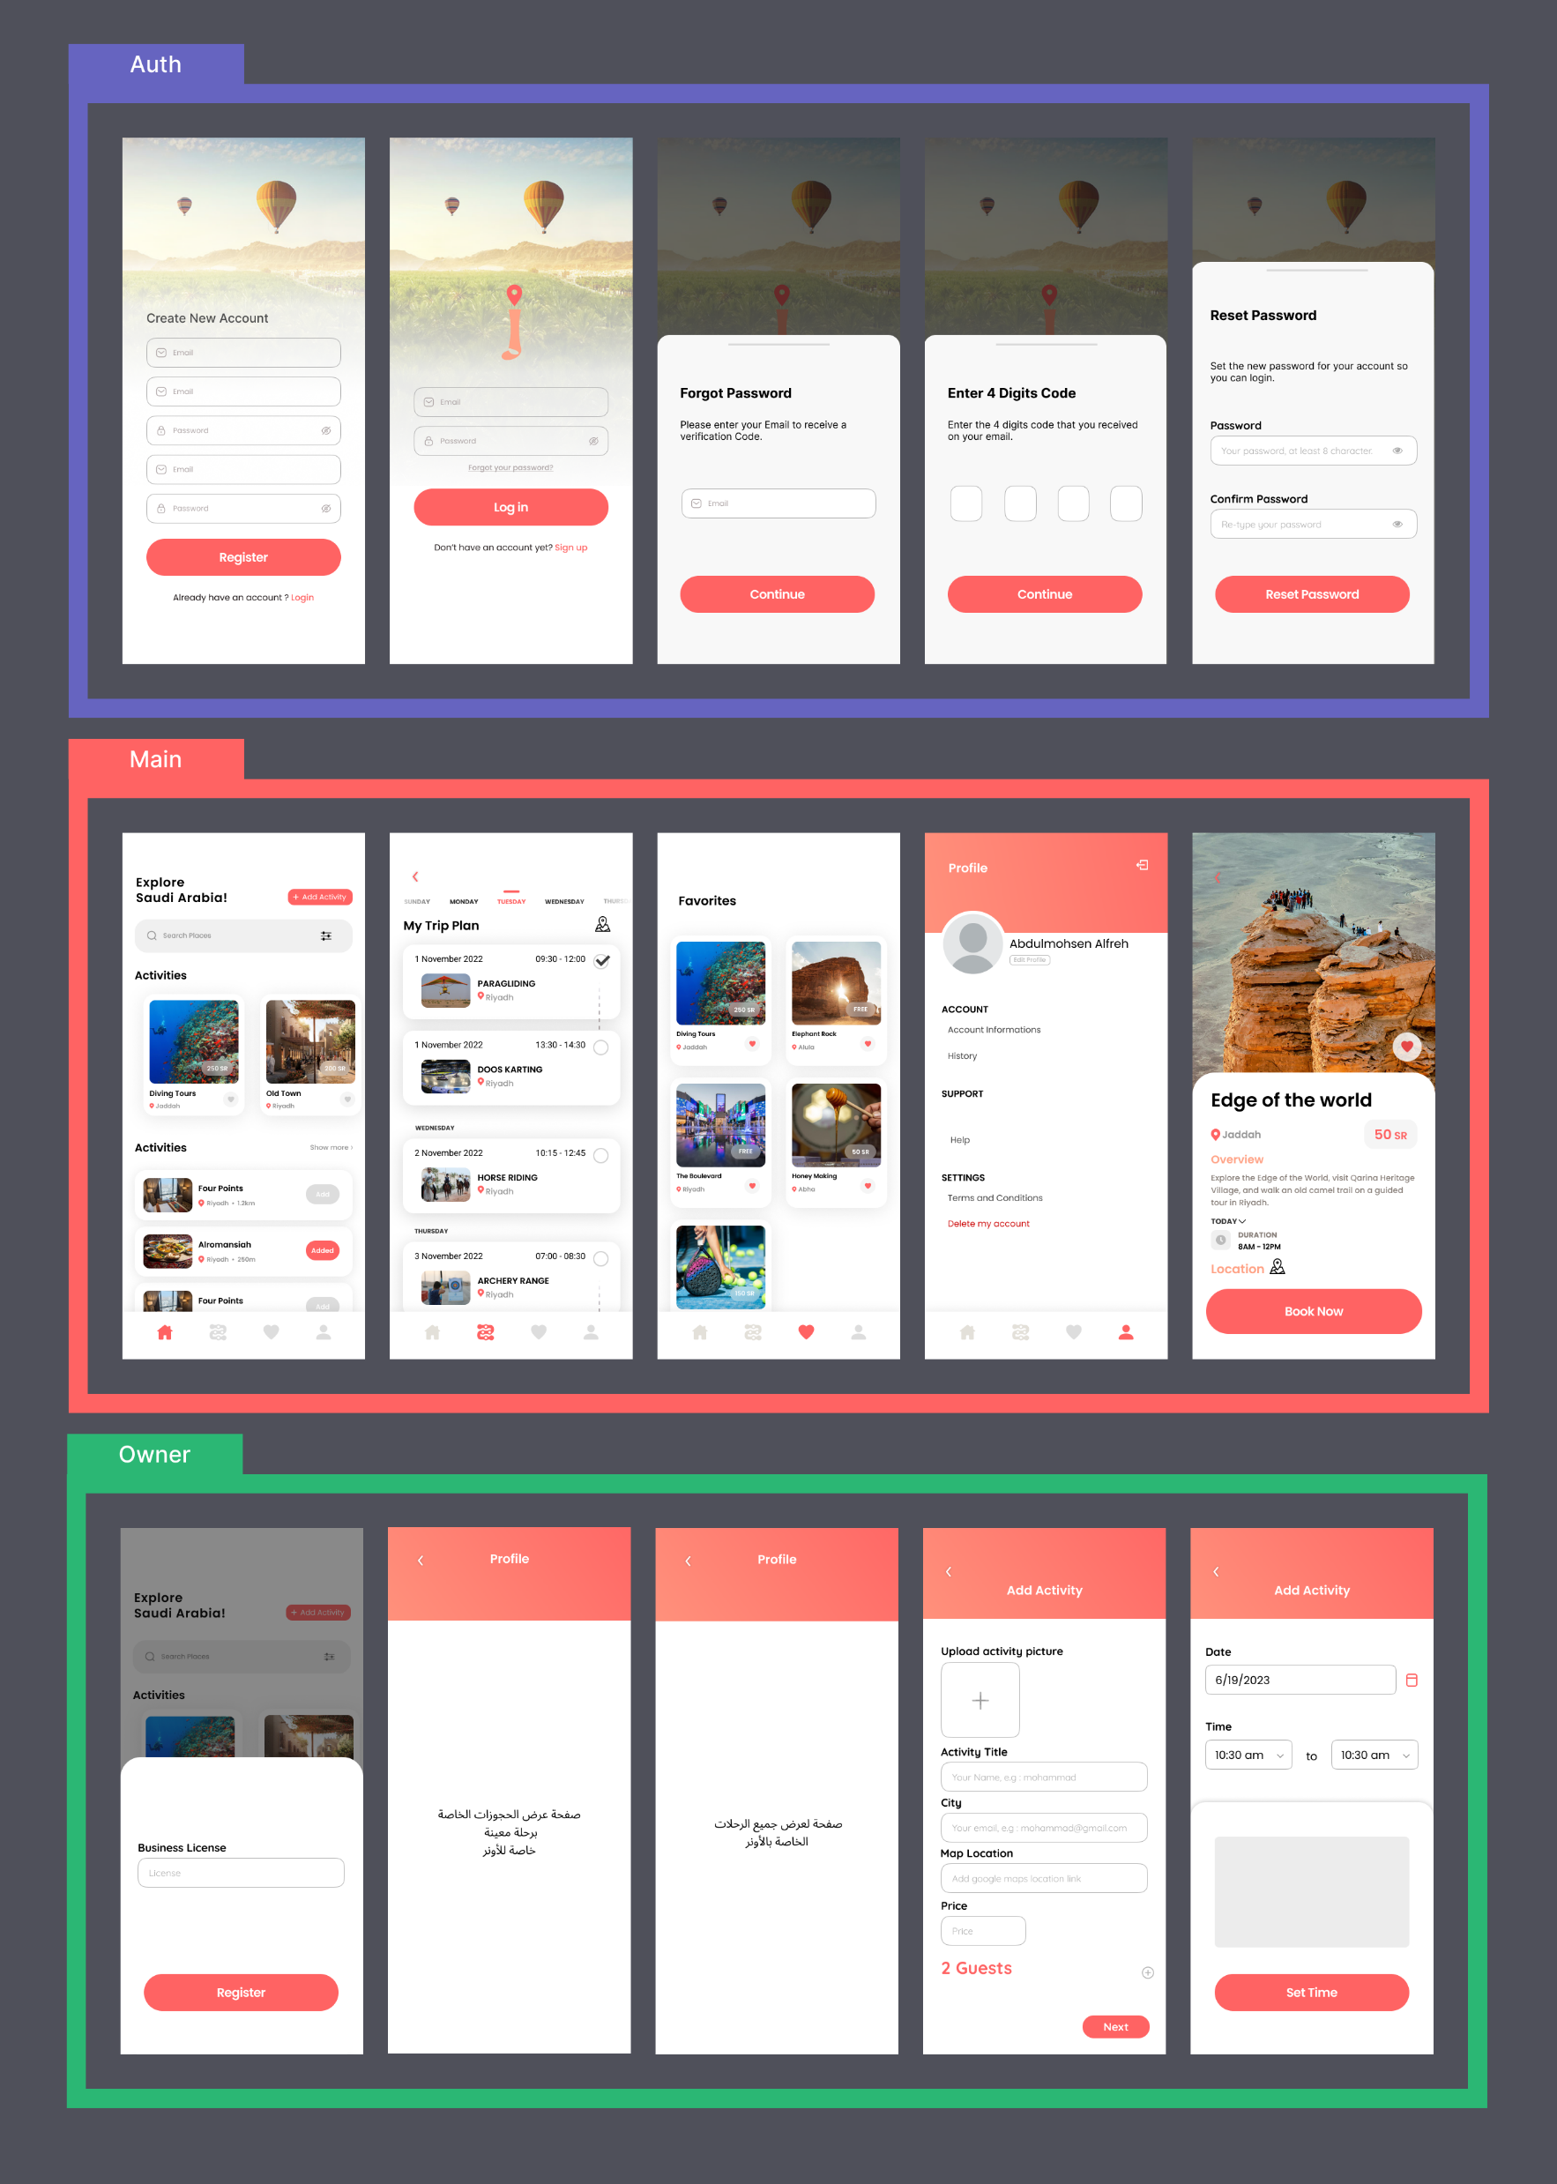
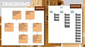
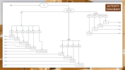
WORK PLAN
UI/UX
ACTIVITY DIAGRAM

Slide 8

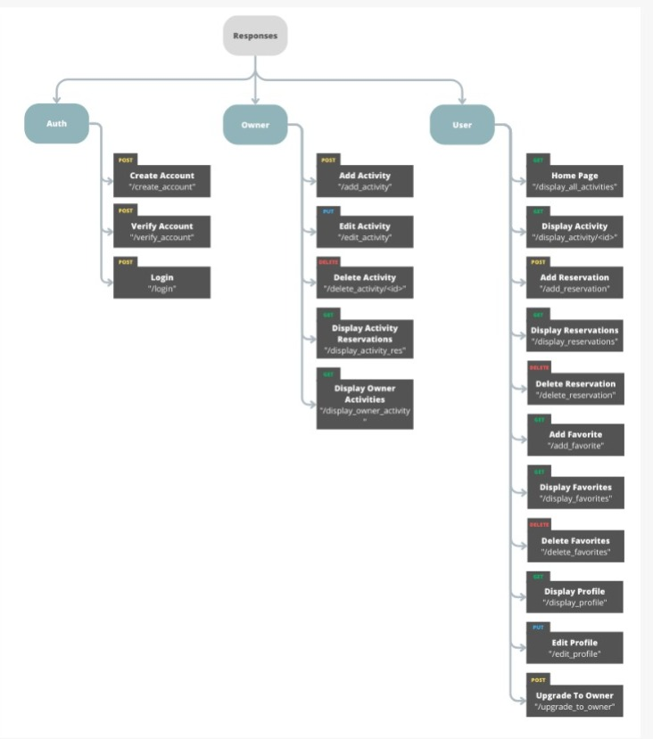
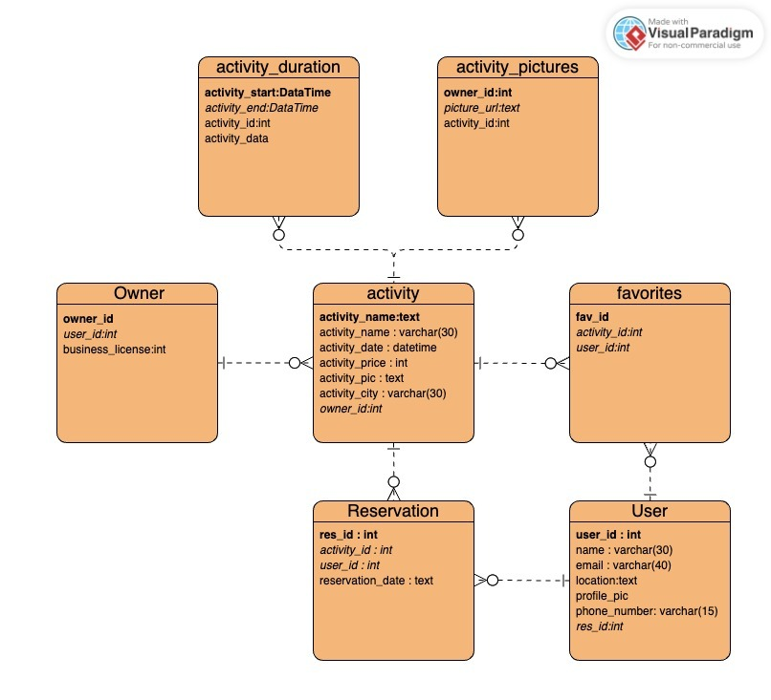
DIAGRAMS
Endpoints
Database

Slide 9
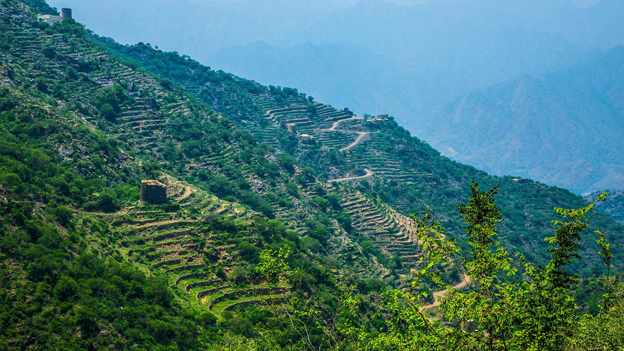






SOFTWARE ENVIRONMENT
FIGMA
GITHUB
POSTMAN
SUPABASE

Slide 10

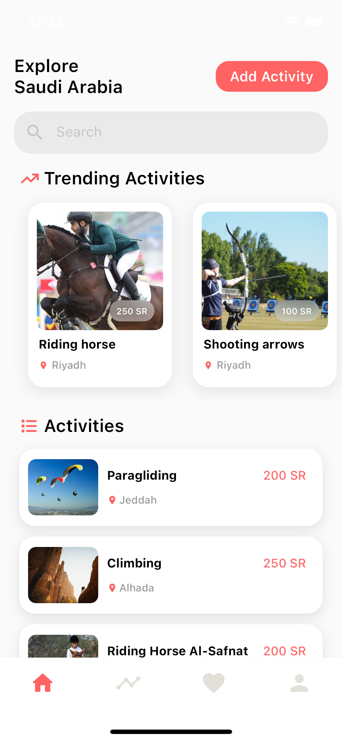
APPLICATION
HOME PAGE

Slide 11





FUTURE PLANS
PACKAGES
FEATURE
SERVICES
FEATURE
MORE
LANGUAGES
FILTER
FEATURE

